Slide 1



Greenspiration ♻️
We inspire sustainability, sustainably
Small steps, every Thursday, have a big impact

Slide 2
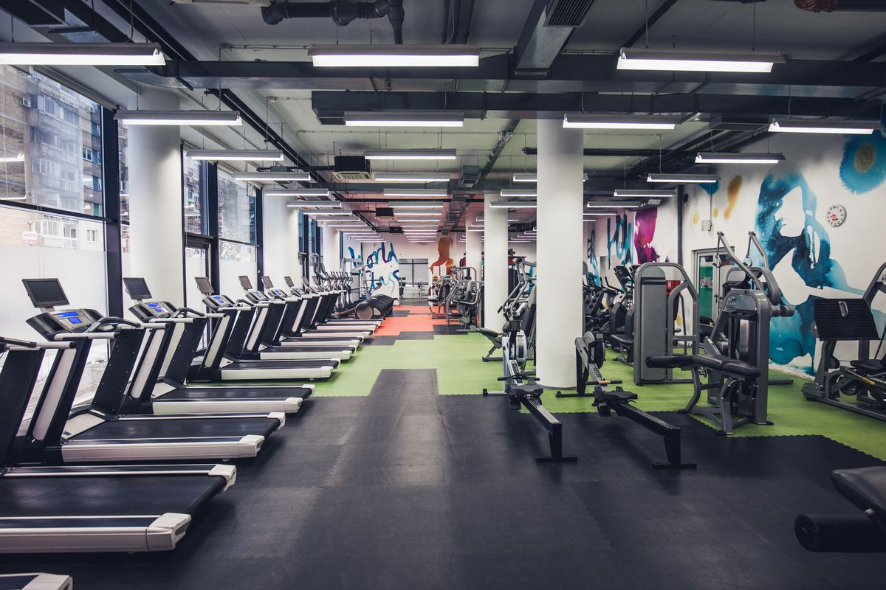

January Gym Goers
Greenspiration ♻️

Slide 3


















Mind the, gap in the market!
There are a LOT of options already on the market
Track, reduce, offset models
Sustainability = Education + Action + User retention
Greenspiration ♻️

Slide 4
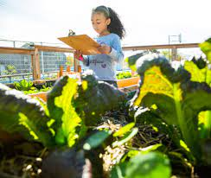
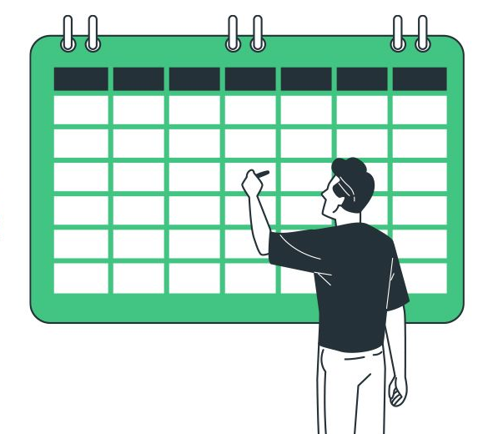
Our USP
✅ Thursday
✅ 1 key source of emissions
✅ Learn, track & share, sustainably
✅ Share barriers and challenges
✅ Increase our understanding of climate privilege and accessibility
Greenspiration ♻️

Slide 5
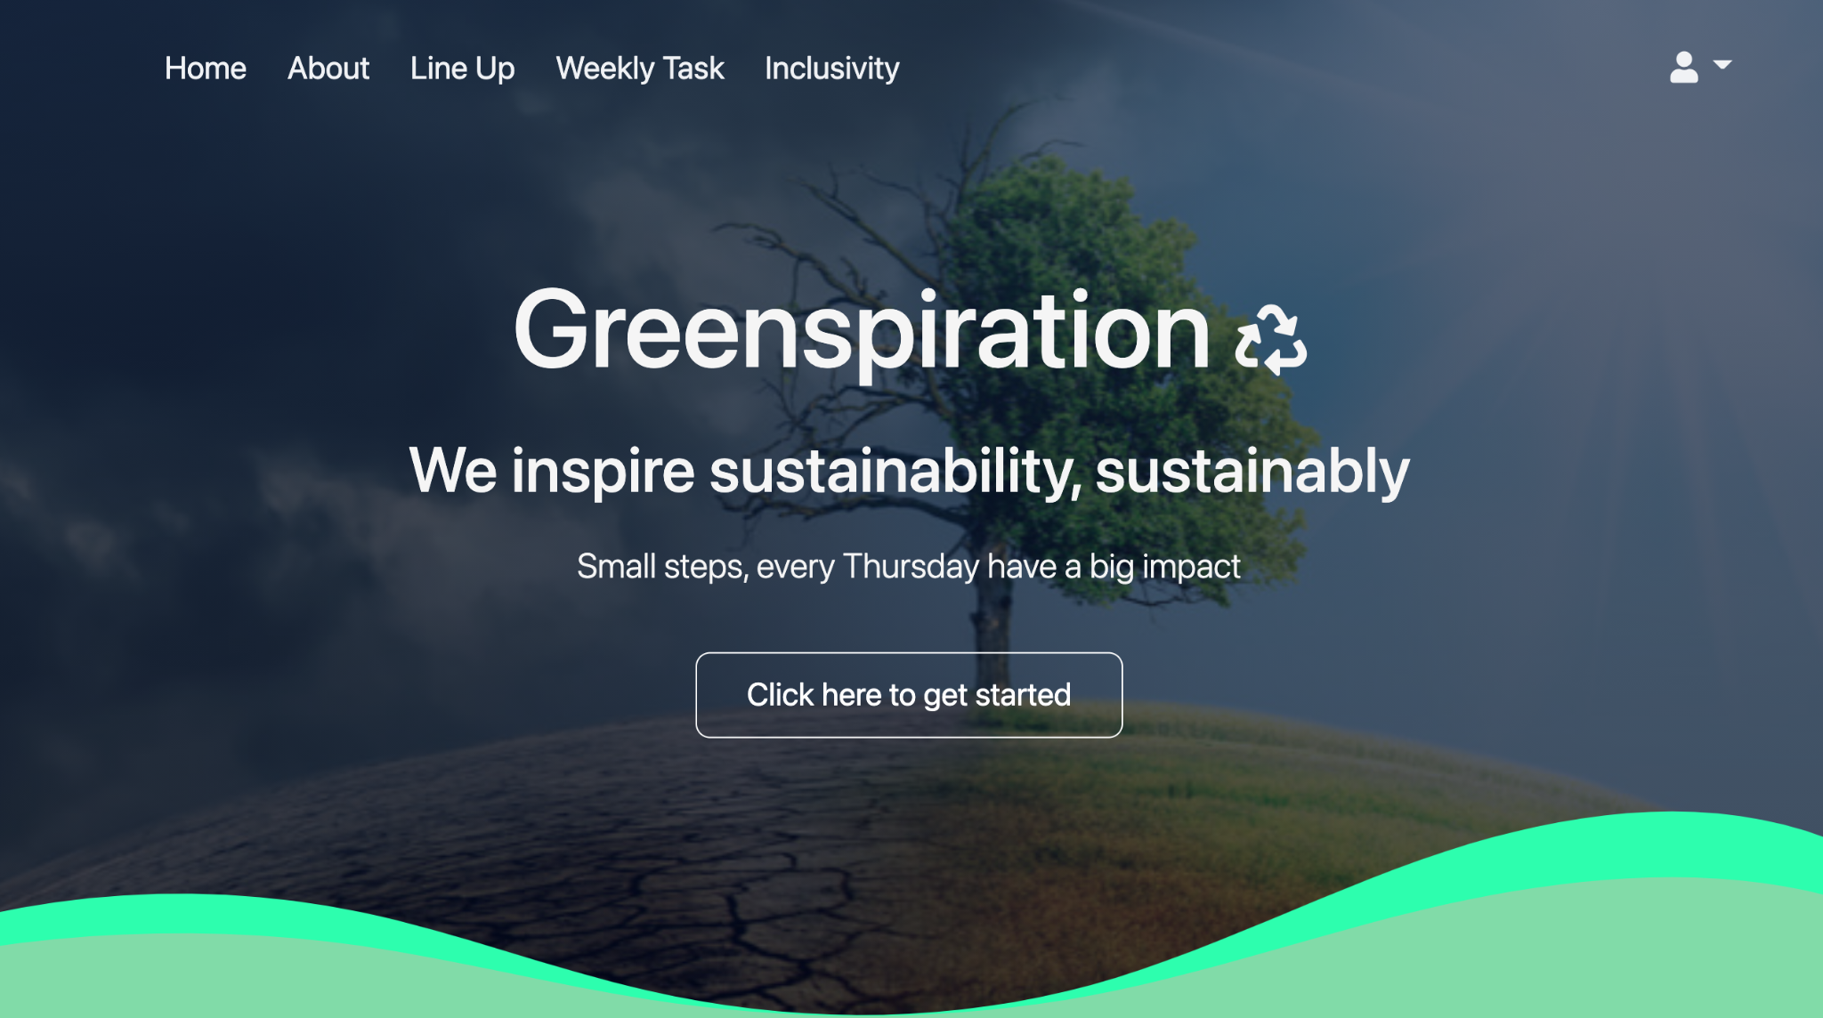



https://kj1080.github.io/TeamJHackathon/index.html

Slide 6

Beyond the MVP, Inclusivity
We have baked in Accessibility & Inclusivity to Greenspiration from the beginning
Accessibility settings, text, audio options
Select different day or frequency
I would like to…
Language options
Highly personalisable
Neurodiverse, all ages & pronouns
Greenspiration ♻️

Slide 7
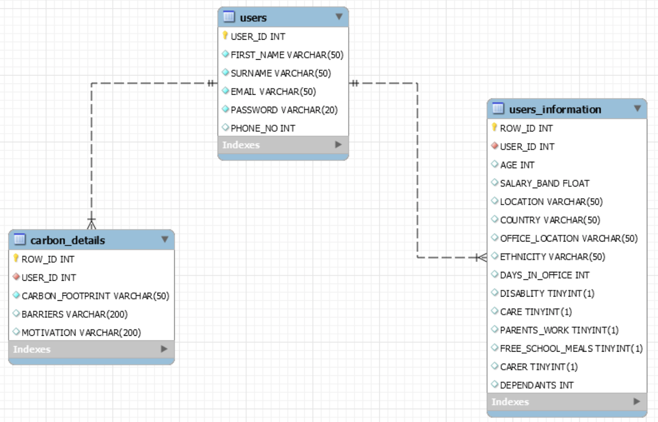
Beyond the MVP, Data
MySQL
Analyse users_information against carbon_details
Personalised climate coaching
Establish patterns →
informed decisions
Greenspiration ♻️

Slide 8
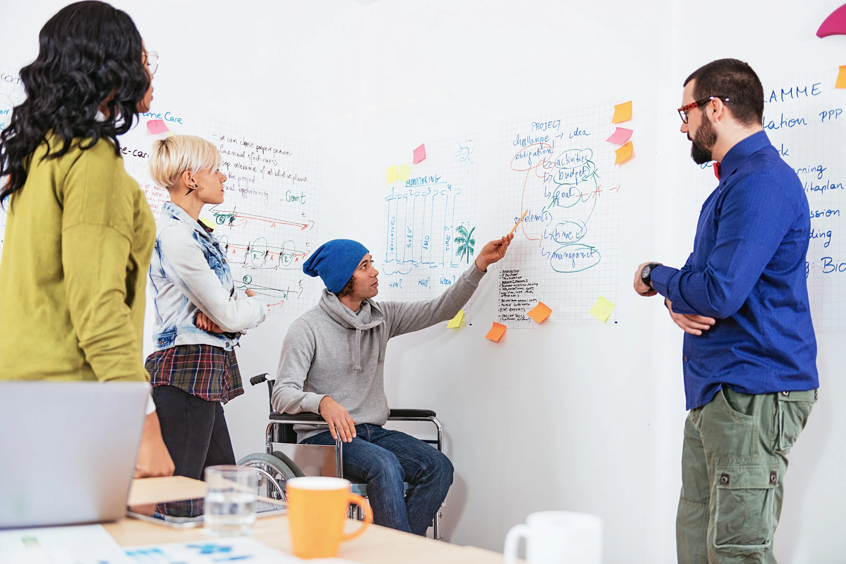
Beyond the MVP, Companies
Brainstorming platform
Engage and empower employees
One key problem to solve collectively per week
Kick start conversations
Greenspiration ♻️

Slide 9
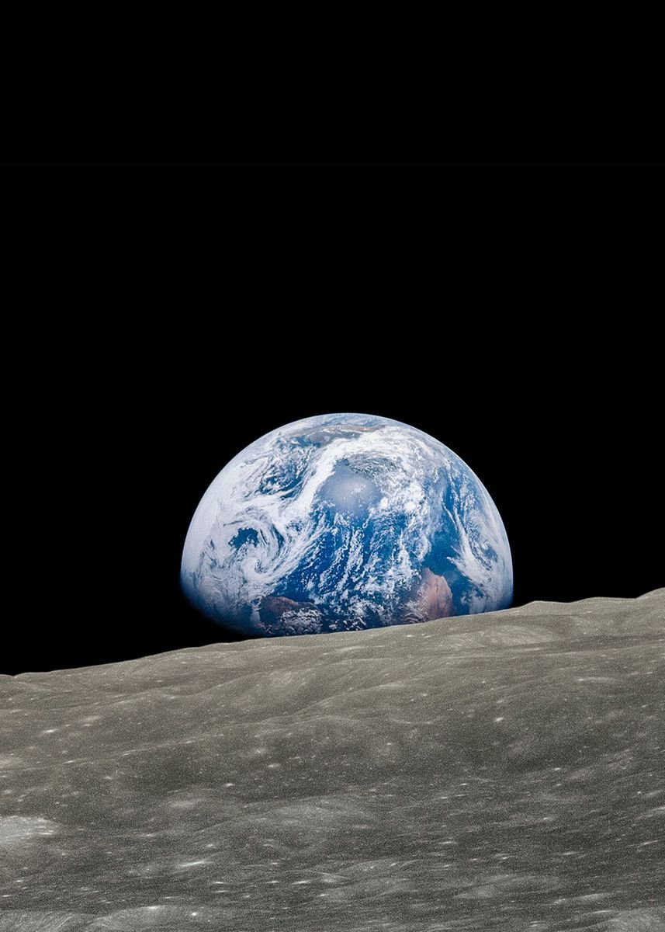
Beyond the MVP, UX/UI
Content for future weeks
Badges
Option to share progress
Discussion forums for ideas, comparing experiences and more
App and mobile friendly website
Feedback loop using data collected and analysed
Data and feedback focused
Greenspiration ♻️

Slide 10
Thank you for listening
And a special thank you to our wonderful mentors Lisa, Mark and Tom!
Greenspiration ♻️

